Slide 1
Information Retrieval Systems
Cataloging and Indexing UNIT - II

Slide 2
AGENDA
History and Objectives of Indexing, Indexing Process, Automatic Indexing, Information Extraction
Data Structure: Introduction to Data Structure, Stemming Algorithms
Inverted File Structure, N-Gram Data Structures, PAT Data Structure, Signature File Structure
Hypertext and XML Data Structures, Hidden Markov Models.

Slide 3
Overview
The transformation from the received item to the searchable data structure is called Indexing.
This process can be manual or automatic.
Creating the basis for direct search of items in the Document Database or indirect search via Index Files.
Once the searchable data structure has been created, techniques must be defined that correlate the user-entered query statement to the set of items in the database to determine the items to be returned to the user. This process is called Search.

Slide 4
History
Indexing (originally called cataloging) is the oldest technique for identifying the contents of item to assist in their retrieval
Subject indexing ->hierarchical subject indexing
Indexing creates a bibliographic citation in a structured file that reference the original text
Citation information about the items, key wording the subjects of the item, and a constrained length free text field used for an abstract/summary
Usually performed by professional indexers
Automatic indexing and Full text search

Slide 5
Objectives
Total document indexing
Controlled vocabulary
Uncontrolled vocabularies
Automatic text analysis algorithms
Public file indexer
Private index files
Selective indexing
Full document indexing

Slide 6
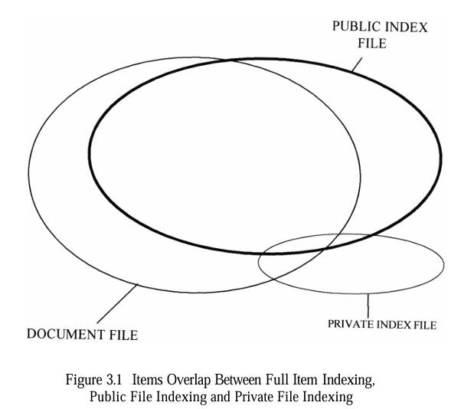
Objectives

Slide 7
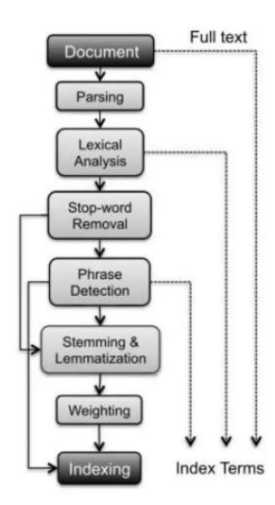
Text Processing

Slide 8
Text Processing - Document Parsing
Documents come in all sorts of languages, character sets, and formats; often, the same document may contain multiple languages or formats, e.g., a French email with Portuguese PDF attachments.
Document parsing deals with the recognition and "breaking down" of the document structure into individual components.
In this pre processing phase, unit documents are created; e.g., emails with attachments are split into one document representing the email and as many documents as there are attachments.

Slide 9
Text Processing - Lexical Analysis
After parsing, lexical analysis tokenizes a document, seen as an input stream, into words.
Issues related to lexical analysis include the correct identification of accents, abbreviations, dates, and cases.
The difficulty of this operation depends on the language at hand: for example, the English language has neither diacritics nor cases, French has diacritics but no cases, German has both diacritics and cases.

Slide 10
Text Processing - Stop-Word Removal
A subsequent step optionally applied to the results of lexical analysis is stop-word removal, i.e., the removal of high­ frequency words.
For example, given the sentence "search engines are the most visible information retrieval applications" and a classic stop words set such as the one adopted by the Snowball stemmer, the effect of stop-word removal would be: "search engine most visible information retrieval applications".

Slide 11
Text Processing - Phrase Detection
This step captures text meaning beyond what is possible with pure bag-of-word approaches, thanks to the identification of noun groups and other phrases.
Phrase detection may be approached in several ways, including rules (e.g., retaining terms that are not separated by punctuation marks), morphological analysis , syntactic analysis, and combinations thereof.
For example, scanning our example sentence "search engines are the most visible information retrieval applications" for noun phrases would probably result in identifying "search engines" and "information retrieval".

Slide 12
Text Processing - Stemming and Lemmatization
Following phrase extraction, stemming and lemmatization aim at stripping down word suffixes in order to normalize the word.
In particular, stemming is a heuristic process that "chops off' the ends of words in the hope of achieving the goal correctly most of the time; a classic rule based algorithm for this was devised by Porter.
According to the Porter stemmer, our example sentence "Search engines are the most visible information retrieval applications" would result in: "Search engine are the most visible inform retrieve application".

Slide 13
Text Processing - Stemming and Lemmatization
Lemmatization is a process that typically uses dictionaries and morphological analysis of words in order to return the base or dictionary form of a word, thereby collapsing its inflectional forms.
For example, our sentence would result in "Search engine are the most visible information retrieval application'' when lemmatized according to a WordNet-based lemmatizer

Slide 14
Text Processing - Weighting
The final phase of text pre processing deals with term weighting.
As previously mentioned, words in a text have different descriptive power; hence, index terms can be weighted differently to account for their significance within a document and/or a document collection.
Such a weighting can be binary, e.g., assigning O for term absence and 1 for presence.

Slide 15
Indexing Process
When an organization with multiple indexers decides to create a public or private index, some procedural decisions assist the indexers and end users on how to create the index terms.
scope of the indexing
linking index terms
Scope of Indexing
defines the level of detail that the subject index will contain.
This is based upon usage scenarios of the end users.
When performed manually, the process of determining the bibliographic terms that represent the concepts in an item is difficult.

Slide 16
Scope of Indexing
Problems arise from interaction of two sources: the author and the indexer.
The vocabulary domain of the author may be different than that of the indexer, causing the indexer to misinterpret the importance.
The indexer is not an expert on all areas and has different levels of knowledge in the different areas being presented in the item.
This results in different quality levels of indexing.
The indexer must determine when to stop the indexing process.
There are two factors involved in deciding on what level to index the concepts in an item:
Exhaustivity
Specificity

Slide 17
Scope of Indexing
Exhaustivity of indexing
is the extent to which the different concepts in the item are indexed.
For example, if two sentences of a 10-page item on microprocessors discusses on-board caches, should this concept be indexed?
Specificity
relates to the preciseness of the index terms used in indexing.
For example, whether the term “processor” or “microcomputer” or “Pentium” should be used in the index of an item.
using general index terms yields low exhaustivity and specificity

Slide 18
Scope of Indexing
This approach requires a minimal number of index terms per item.
reduces the cost of generating the index.
Another decision on indexing is what portions of an item should be indexed.
The simplest case is to limit the indexing to the Title or Title and Abstract zones.
Weighting
Weighting of index terms is not common in manual indexing systems.
Weighting is the process of assigning an importance to an index term’s use in an item.
The weight should represent the degree to which the concept associated with the index term.
The process of assigning weights adds additional overhead on the indexer and requires a more complex data structure to store the weights.

Slide 19
Precoordination and Linkage
Another decision on the indexing process is whether linkages are available between index terms for an item.
Linkages are used to correlate related attributes associated with concepts discussed in an item.
Precoordination
process of creating term linkages at index creation time.
When index terms are not coordinated at index time, the coordination occurs at search time.

Slide 20
Precoordination and Linkage
Post coordination
coordinating terms after (post) the indexing process.
implemented by “AND” ing index terms together, which only finds indexes that have all of the search terms.
Figure below shows the different types of linkages.
It assumes that an item discusses the drilling of oil wells in Mexico by CITGO and the introduction of oil refineries in Peru by the U.S.
When the linked capability is added, the system does not erroneously relate Peru and Mexico since they are not in the same set of linked items.

Slide 21
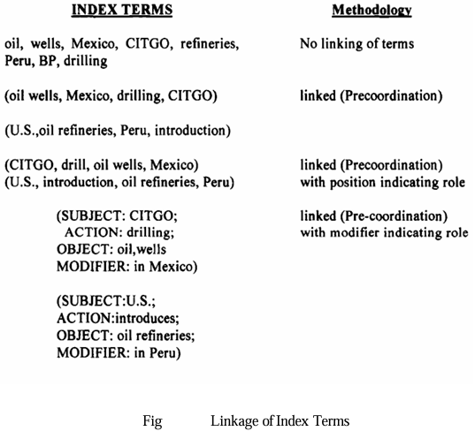
It still does not have the ability to discriminate between which country is introducing oil refineries into the other country.
Introducing roles in the last two examples of Figure removes this ambiguity.

Slide 22
Automatic Indexing
Automatic indexing is the process by which an Information Retrieval System (IRS) analyzes, processes, and assigns keywords or index terms to documents without human intervention.
This process helps in efficient storage, retrieval, and ranking of documents in a database or search engine.

Slide 23
Automatic Indexing - steps
Text Preprocessing
Tokenization (breaking text into words or phrases)
Stop-word removal (eliminating common words like "the", "is", "and")
Stemming & Lemmatization (reducing words to their base form, e.g., "running" → "run")
Feature Extraction
Identifying important terms or concepts in the document
Can involve statistical, linguistic, or machine learning techniques

Slide 24
Automatic Indexing - steps
Weight Assignment
TF-IDF (Term Frequency-Inverse Document Frequency): Measures how important a term is in a document compared to the entire dataset
Word Embeddings (e.g., Word2Vec, BERT): Captures the contextual meaning of words
Latent Semantic Indexing (LSI): Identifies hidden relationships between words

Slide 25
Automatic Indexing - steps
Indexing Structure Creation
Terms are stored in an inverted index, which maps words to the documents they appear in
Can be enhanced using hash tables, B-trees, or tree structures
Document Ranking & Retrieval
Search queries are matched against the indexed terms
Documents are ranked based on similarity measures

Slide 26
Automatic Indexing
Statistical Indexing
Uses frequency-based methods (TF-IDF, n-grams)
Example: Google Search Engine
Linguistic Indexing
Uses Natural Language Processing (NLP) techniques
Example: Semantic Search Engines
Machine Learning-Based Indexing
Uses AI to learn from previous searches and improve indexing
Example: Neural Information Retrieval Systems

Slide 27
Automatic Indexing - Advantages
Efficiency - Capability for the system to automatically determine the index terms to be assigned to an item.
Scalability - More complex processing is required when emulate a human indexer and determine a limited number of index terms.
Reduced manual effort - No additional indexing costs versus the salaries and benefits regularly paid to human indexers.
Process large collection of documents quickly. Requires only a few seconds or less of computer time based upon the size of the processor and the complexity of the algorithms to generate the index.
Consistency - Consistency in the index term selection process as indexing is performed automatically by an algorithm.

Slide 28
Automatic Indexing - Types
Indexing by Term
Indexing by Concept
Multimedia Indexing

Slide 29
Automatic Indexing - Indexing by Term
There are two major techniques for creation of the index terms:
statistical
based upon vector models and probabilistic models with a special case being Bayesian models
calculation of weights in those models use statistical information such as the frequency of occurrence of words and their distributions in the searchable database.
natural language
perform more complex parsing to define the final set of index concepts.
weighted systems are discussed as vectorized information systems.

Slide 30
Automatic Indexing - Indexing by Term – Vector model
Vector model (example. SMART system)
The system emphasizes weights as a foundation for information detection and stores these weights in a vector form.
Each vector represents a document.
Each position in a vector represents a different unique word (processing token) in the database.
A value of zero indicates that the word was not in the document.
Queries can be translated into the vector form.
Search is accomplished by calculating the distance between the query vector and the document vectors.

Slide 31
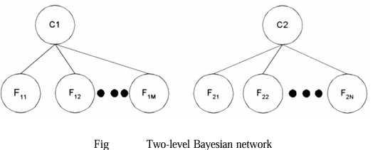
Automatic Indexing - Indexing by Term – Probabilistic model
A Bayesian network is a directed acyclic graph in which each node represents a random variable and the arcs between the nodes represent a probabilistic dependence between the node and its parents .

Slide 32
Automatic Indexing - Indexing by Term – Probabilistic model
The nodes C₁ and C₂ represent “the item contains concept C_{i}” F nodes represent “the item has feature F_{ij} (e.g., words)
To perform that calculation two sets of probabilities are needed:
The prior probability P(C_{i}) that an item is relevant to concept C.
The conditional probability P(F_{ij}/C_{i}) that the features F_{ij} where j=1,m are present in an item given that the item contains topic C_{i}.

Slide 33
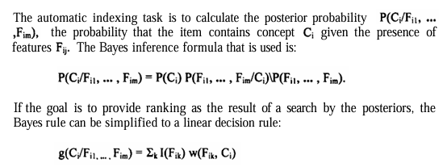
Automatic Indexing - Indexing by Term – Probabilistic model

Slide 34
Automatic Indexing - Indexing by Term
DR-LINK (Document Retrieval through Linguistic Knowledge) system
define indexes to items via natural language processing.
processes items at the morphological, lexical, semantic, syntactic, and discourse levels.
Each level uses information from the previous level to perform its additional analysis.
The discourse level is abstracting information beyond the sentence level and can determine abstract concepts.
This allows the indexing to include specific term as well as abstract concepts such as time.

Slide 35
Automatic Indexing - Indexing by Concept
Latent Semantic Indexing
Indexing the latent semantic information in items
MatchPlus system.
Example for concept indexing.
neural networks facilitates machine learning of concept/word relationships.
Two neural networks are used.
One neural network learning algorithm generates stem context vectors that are sensitive to similarity of use.
another one performs query modification based upon user feedback.

Slide 36
Automatic Indexing - Indexing by Concept
context vectors
Word stems, items and queries that are represented by high dimensional (atleast 300 dimensions) vectors.

Slide 37
Multimedia Indexing
The first pass in most cases is a conversion from the analog input mode into a digital structure.
Then algorithms are applied to the digital structure to extract the unit of processing of the different modalities that will be used to represent the item.
In an abstract sense this could be considered the location of a processing token in the modality.

Slide 38
Multimedia Indexing
Indexing video or images can be accomplished
At the raw data level (e.G., The aggregation of raw pixels),
The feature level distinguishing primitive attributes such as color and luminance
At the semantic level where meaningful objects are recognized (e.G., An airplane in the image/video frame).

Slide 39
Multimedia Indexing
In addition to storing the extracted index searchable data, a multimedia item also needs to store some mechanism to correlate the different modalities during search.
There are two main mechanisms that are used
Positional
Temporal
Positional is used when the modalities are scattered in a linear sequential composition.
For example a document that has images or audio inserted, can be considered a linear structure and the only relationship between the modalities will be the just a position of each modality.

Slide 40
Multimedia Indexing
Temporal based upon time because the modalities are executing concurrently. The typical video source off television is inherently a multimedia source. It contains video, audio, and potentially closed captioning.
Synchronized Multimedia Integration Language (SMIL).
creation of multimedia presentations are becoming more common using the Synchronized Multimedia Integration Language (SMIL).
It is a mark-up language designed to support multimedia presentations that integrate text (e.g., from slides or free running text) with audio, images and video.

Slide 41
Information Extraction
There are two processes associated with information extraction:
determination of facts to go into structured fields in a database
only a subset of the important facts in an item may be identified and extracted.
extraction of text that can be used to summarize an item.
all the major concepts in the item should be represented

Slide 42
Information Extraction - Extraction
The process of extracting facts to go into indexes is called Automatic File Build.
Its goal is to process incoming items and extract index terms that will go into a structured database.
Extraction system analyzes only the portions of a document that contain information relevant to the extraction criteria.

Slide 43
Information Extraction - Extraction
The term “slot” is used to define a particular category of information to be extracted.
Metrics to compare information extraction
Recall
Over generation
It measures the amount of irrelevant information that is extracted.
Fallout
It measures how much a system assigns incorrect slot fillers.

Slide 44
Information Extraction - Document summarization
goal is to extract a summary of an item maintaining the most important ideas while significantly reducing the size.
Examples of summaries are part of any item such as titles, table of contents, and abstracts.
The abstract can be used to represent the item for search purposes or to determine the item without having to read the complete item.

Slide 45
Information Extraction - Document summarization
It is not feasible to automatically generate a coherent narrative summary of an item with proper discourse, abstraction and language usage.
Restricting the domain of the item significantly improves the quality of the output.
Different algorithms produce different summaries.
Most automated algorithms summarize by calculating a score for each sentence and then extracting the sentences with the highest scores.

Slide 46
Data Structures
Introduction to Data Structure
Stemming Algorithms
Inverted File Structure
N-Gram Data Structures
PAT Data Structure
Signature File Structure
Hypertext and XML Data Structures
Hidden Markov Models.

Slide 47
Introduction to Data Structure
The knowledge of data structure gives an insight into the capabilities available to the system .
Each data structure has a set of associated capabilities .
Ability to represent the concept and their representation.
Two major data structures in any IRS:
1. One structure stores and manages received items in their normalized form is called document manger.
2. The other data structure contains processing tokens and associated data to support search document search manger.

Slide 48
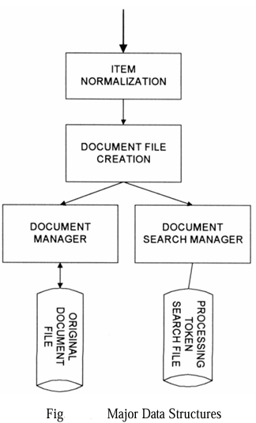
Introduction to Data Structure
Result of a search are references to the items that satisfy the search statement which are passed to the document manager for retrieval.
Focus : on data structure that support search function

Slide 49
Stemming Algorithms
Stemming Algorithms
Table look-up Stemming
Porter stemming
Dictionary look-up stemming
Successor stemming
Cutoff method
Peak and Plateau
Complete word method
Entropy method

Slide 50
Stemming Algorithms
Stemming algorithm is used to improve the efficiency of IRS and improve recall.
It eliminates prefixes and suffixes from words, transforming them into their fundamental or root form.
For example we cutting down the branches of a tree to its stems.
Stem carriers the meaning if the concept associated with the word and the ending introduces slight modifications of the concept.

Slide 51
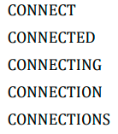
Stemming Algorithms
CALCULATE
CALCULATES
CALCULATION
CALCULATIONS
CALCULATING
Major usage of stemming is to improve recall

Slide 52
Stemming Vs Lemmatization
Stemming | Lemmatization
Can reduce words to a stem that is not an existing word | Reduces inflected words to their lemma, which is always the existing word
Operators on a single word without knowledge of the content | Can leverage context to find the correct lemma of a word
Simple and faster | More accurate but slower
Ex: Change Changing Chang Changed | Ex: Change Changing Change Changed

Slide 53
Table lookup
It store a table of all index terms and their stems , so terms from queries and indexes could be stemmed very fast.
Its constructed with stem for every word
Systems use a combination of dictionary lookup and conflation rules
Problem
There is no such data for English
The storage overhead for such a table

Slide 54
Porter stemming Algorithm
A stem is a part of a word
In Porter stemming following some conditions based on vowels(a,e,i,o,u) and consonants.
Example : CONNECTING have “ING” suffix
To eliminate the suffix we perform stemming
this algorithm is used to remove the suffixes from an English word and obtain its stem.
It is very useful in IRS

Slide 55
Porter stemming Algorithm
The measure, m, of a stem is a function of sequences of vowels (a, e, i, o, u) followed by a consonant. If V is a sequence of vowels and C is a sequence of consonants,
then m is C(VC)^{m}V
Vowels(v) , Consonants(c), measure(m)

Slide 56
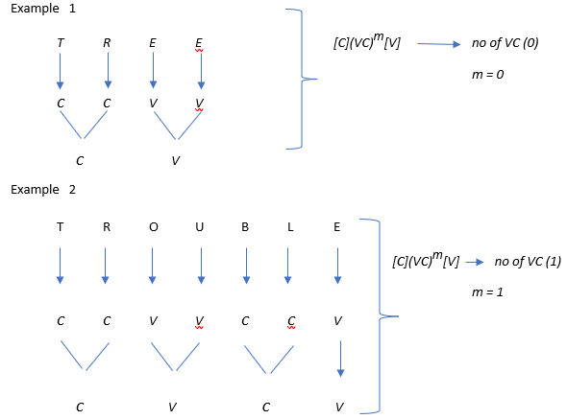
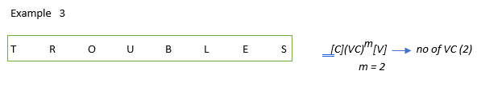

Slide 57
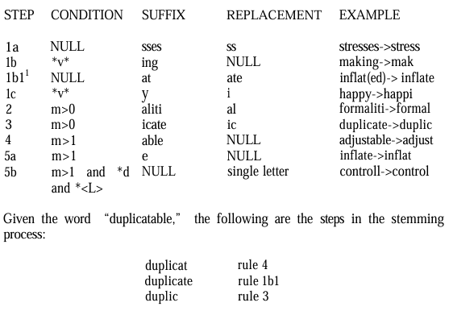
Porter stemming Algorithm - Example

Slide 58
Dictionary Look-Up stemming
The original term or stemmed version of the term is looked up in a dictionary and replaced by the stem that best represents it.
This technique has been implemented in the INQUERY and Retrieval Ware Systems.
The INQUERY system uses a stemming technique called Kstem.
Kstem is a morphological analyzer that conflates word variants to a root form.
The Kstem system uses the following six major data files to control and limit the stemming process

Slide 59
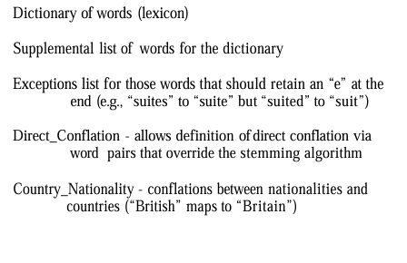


Slide 60
Successor Stemmers Algorithm
based upon the length of prefixes
the smallest unit of speech that distinguish one word from another
The process determines the successor varieties for a word
Here once the algorithm takes substrings of a term will decrease as more characters are added until a segment boundary is reached.
The stemming method based on this work uses letters in place of phonemically transcribed utterances

Slide 61
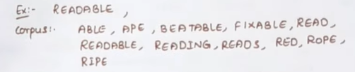
Cutoff method
We can use 4 methods to successor variety of words.
Cutoff method: a cutoff value is selected to define stem length. The value varies for each possible set of words

Slide 62
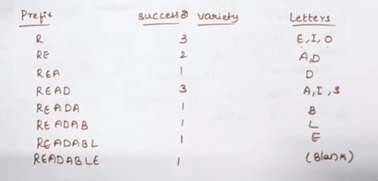
Cutoff method - Example

Slide 63
Peak and Plateau
a segment break is made after a character whose successor variety(SV) exceeds that of the character immediately preceding it
Successor Variety (SV) measures how many unique characters come after a given character in a word.
The more different characters that follow a character, the higher its successor variety.
The fewer different characters that follow a character, the lower its successor variety.
Break at the character whose successor variety is greater than both its preceding and following characters
Example: READ|ABLE

Slide 64
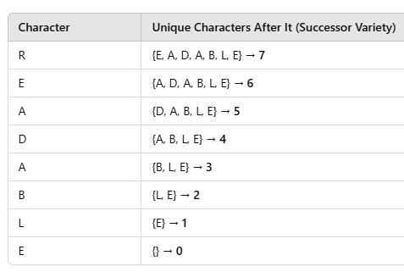
Peak and Plateau - Example

Slide 65
Complete word method
Complete word method: break on boundaries of complete words.
Its made if the segment is complete word in the corpus(READ)
It assumes that a word should be segmented at points where meaningful words or subwords exist.
This method is commonly used in dictionary-based word segmentation.
It ensures that each resulting segment is a valid word or part of a word (such as a root, prefix, or suffix).

Slide 66
Complete word method - Example
Check for meaningful words or subwords:
"read" ✅ (valid word)
"able" ✅ (valid word)
Final segmentation:
"read | able"

Slide 67

Entropy method
Entropy method: uses the distribution of successor variety letters.
Let |D_{ak}| be the number of words beginning with the k length sequence of letters a.
Let |D_{akj}| be the number of words in D_{ak} with successor j.
The probability that a member of D_{ak} has the successor j is given by |D_{akj}|/|D_{ak}|.
The entropy (Average Information as defined by Shannon-51) of |D_{ak}| is:

Slide 68
Inverted File Structure
It is a data structure , it allows efficient full text searches in the database.
It stores a mapping of words to their locations in the database table or document
Inverted file structures are composed of three basic files: the document file, the inversion lists (sometimes called posting files) and the dictionary.
Inverted file based on methodology of storing an inversion of documents.
For each word a list of documents in which the word is found is stored
Each document is given a unique numerical identifier that is stored in inversion list.
Which is sorted list in the system and a pointer to the location of its inversion list

Slide 69
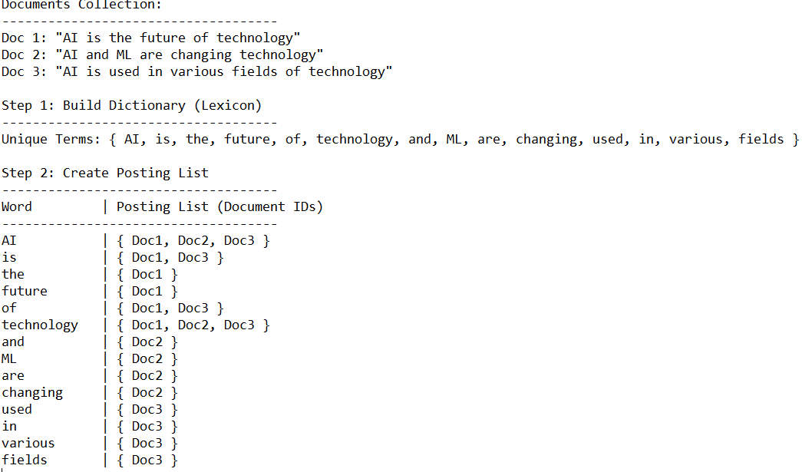

Slide 70
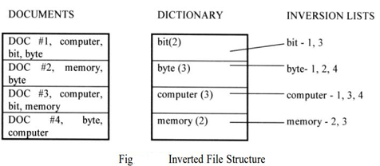
Inverted File Structure

Slide 71
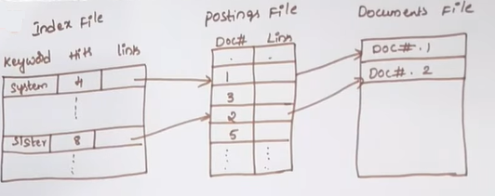
Inverted File Structure

Slide 72
Inverted File Structure
Using Zoning to improve
Inversion list contains document identifier for each document in which the word is found.
Inversion list are used to store concept and their relationship
Words with special characteristics can be stored in their own directory

Slide 73
N-Gram Data Structures
N- grams can be viewed as special technique for conflation and as a unique data structure in IS .
These are fixed length of consecutive series of 'n' characters.
In stemming we care about stemming but n-gram data structure we don't care about semantics
Here we are observing
Unigram : how often a world occurs without looking at previous word.
Bigram: only the previous word to predict current word
Trigram : previous two words are considered

Slide 74
N-Gram Data Structures
Here using Symbol, # is to represent the interword , which is anyone of a set of symbols
Each Of the n-grams created becomes a Separate processing tokens and Searchable.
It is possible that the same N-gram can be Created multiple times from a single word.

Slide 75
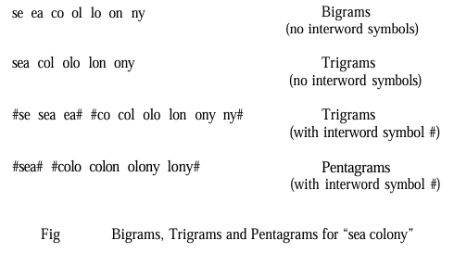
N-Gram Data Structures

Slide 76
PAT Data Structures
The name PAT is short for PAtriciaTrees (PATRICIA stands for Practical Algorithm To Retrieve Information Coded In Alphanumerics.)
Practical algorithm to retrieve information coded in alphanumeric.
Its also called as PAT tree or PAT array
In PAT which string is taken as input that is transformed into a searchable data structure .That is combination of unique substrings.
Each position in a input string is a anchor point for a sub string.
In binary tree most common class for prefix search.
In PAT trees supports strings search also.

Slide 77
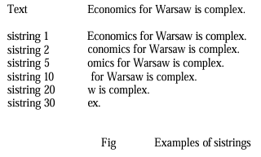
PAT Data Structures

Slide 78
PAT Data Structures
Key values are stored at the leaf nodes
‘n’ input side text having
‘n’ leaf nodes
‘n-1’ level nodes
Internal nodes have no key information.

Slide 79
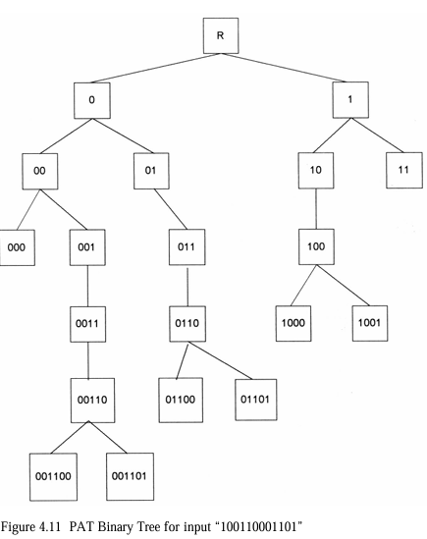

Slide 80
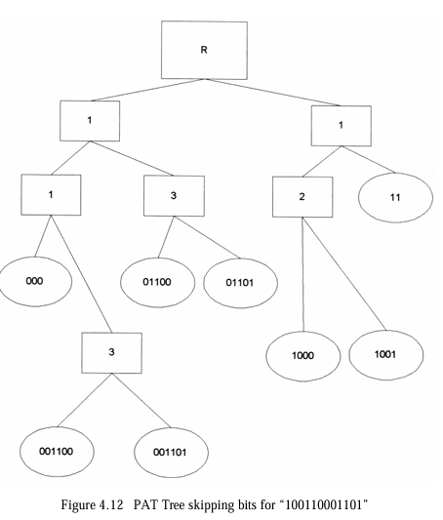

Slide 81
Signature File Structure
Signature Generation:
Each document is tokenized into words. A hashing function converts words into bit patterns.
The bit patterns are combined to create a fixed-length document signature.
Signature Storage:
All document signatures are stored in a sequential file for efficient retrieval.
Query Processing:
The query is also converted into a query signature.
The system compares the query signature with stored document signatures.
False positives (incorrect matches) may occur, requiring verification.

Slide 82
Signature File Structure - Process
Bit Mapping Process
Each word in a document is assigned a bit position using a hash function.
Multiple words set multiple bits in the signature.
Example:
"AI" → 10001000
"Machine" → 00010010
"Learning" → 01000001
Final document signature: 11011011

Slide 83
Signature File Structure - Process
Query Matching
Suppose a query contains "AI" and "Learning".
The query signature is generated.
The system compares the query signature with stored document signatures.
If all query bits match the document signature bits, it is a potential match.

Slide 84
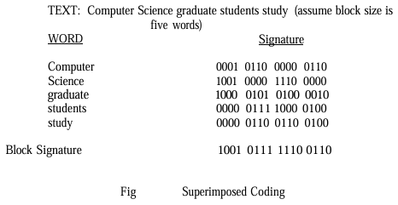
Signature File Structure - Example

Slide 85
Signature File Structure
This technique applied for "Document Retrieval"
The main idea in this technique is to create a quick link to the documents , its matches with query string given by user.
Here “Signature "means fixed length code with a fixed no of bits set to 1.
Dividing of words is done in block size
In Signature file structure
Word oriented index structure
Low overhead
Suitable for conventional databases
Its suitable for not very large text

Slide 86
Signature File Structure - Example
User -> Parsing using Query - > Database
Hash function is used to create signatures.
Input
Hash Function
Output
Document
Fixed size value

Slide 87
Hypertext and XML Data Structures
The advent of the internet and its exponential growth and wide acceptance as a new global information network has introduced new mechanisms for representing information.
This structure is called hypertext and differs from traditional information storage data structures in format and use.
The hypertext is stored in hypertext markup language (html) and extensible markup language (xml).
These languages provide detailed descriptions for subsets of text similar to the zoning

Slide 88
Hypertext
Hypertext allows one item to reference another item via an imbedded pointer. Each separate item is called a node and the reference pointer is called a link.
For example, hypertext markup language (html) defines the internal structure for information exchange across the world wide web on the internet.
A document is composed of the text of the item along with html tags that describe how to display the document.
Tags are formatting or structural keywords contained between less-than, greater than symbols (e.G., <Title>, <strong> meaning display prominently).

Slide 89
Hypertext Markup Language (HTML)
The URL has three components:
the access method the client used to retrieve the item,
the Internet address of the server where the item is stored,
and the address of the item at the server (i.e., the file including the directory it is in).
For example, the URL for the HTML specification appears: http://info.cern.ch/hypertext/WWW/MarkUp/HTML.html

Slide 90
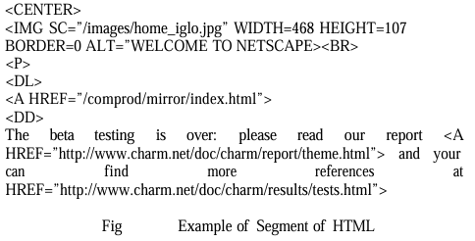
Example - HTML

Slide 91
extensible Markup Language (XML)
Its objective is extending HTML with semantic information.
The logical data structure within XML is defined by a Data Type Description (DTD) and is not constrained to the 70 defined tags and 50 attributes in the single DTD for HTML.
The user can create any tags needed to describe and manipulate their structure. The W3C (Worldwide Web Consortium) is redeveloping HTML as a suite of XML tags.

Slide 92

extensible Markup Language (XML)
Hypertext links for XML are being defined in the Xlink (XML Linking Language) and Xpoint (XML Pointer language) specifications.
Finally XML will include an XML Style Sheet Linking definition to define how to display items on a particular style sheet and handle cascading stylesheets.

Slide 93
Hidden Markov Models
Hidden Markov Models (HMM) have been applied for the last 20 years to solving problems in speech recognition and to a lesser extent in the areas locating named entities (Bikel-97), optical character recognition (Bazzi-98) and topic identification (Kubala-97).
A HMM can best be understood by first defining a discrete Markov process. The easiest way to understand it is by an example. Lets take the example of a three state Markov Model of the Stock Market. The states will be one of the following that is observed at the closing of the market:
State 1 (S1): market decreased
State 2 (S2): market did not change
State 3 (S3): market increased in value

Slide 94

Hidden Markov Models
The movement between states can be defined by a state transition matrix with state transitions (this assumes you can go from any state to any other state):

Slide 95
Hidden Markov Models
Given that the market fell on one day (State 1), the matrix suggests that the probability of the market not changing the next day is 1.
This then allows questions such as the probability that the market will increase for the next 4 days then fall.
This would be equivalent to the sequence of SEQ = {S3, S3, S3, S3, S1}.
let’s assume that instead of the current state being dependent upon all the previous states, lets assume it is only dependent upon the last state.

Slide 96
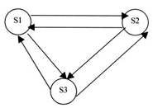
Hidden Markov Models
The following graph depicts the model.
The directed lines indicate the state
transition probabilities a_{ij}.

